Slide 1
Architectural Design
Introduction
Data design
Software architectural styles
(Source: Pressman, R. Software Engineering: A Practitioner’s Approach. McGraw-Hill, 2005)

Slide 2
Introduction

Slide 3
Definitions
The software architecture of a program or computing system is the structure or structures of the system which comprise
  The software components
  The externally visible properties of those components
  The relationships among the components
Software architectural design represents the structure of the data and program components that are required to build a computer-based system
An architectural design model is transferable
  It can be applied to the design of other systems
  It represents a set of abstractions that enable software engineers to describe architecture in predictable ways

Slide 4
Example -Architectural Design
customer requirements
"four bedrooms, three baths,
lots of glass ..."
architectural design

Slide 5
Architectural Design Process
Basic Steps
  Creation of the data design
  Derivation of one or more representations of the architectural structure of the system
  Analysis of alternative architectural styles to choose the one best suited to customer requirements and quality attributes
  Elaboration of the architecture based on the selected architectural style
A database designer creates the data architecture for a system to represent the data components
A system architect selects an appropriate architectural style derived during system engineering and software requirements analysis

Slide 6
Importance of Software Architecture
Representations of software architecture are an enabler for communication between all stakeholders interested in the development of a computer-based system
The software architecture highlights early design decisions that will have a profound impact on all software engineering work that follows and, as important, on the ultimate success of the system as an operational entity
The software architecture constitutes a relatively small, intellectually graspable model of how the system is structured and how its components work together

Slide 7
Emphasis on Software Components
A software architecture enables a software engineer to
  Analyze the effectiveness of the design in meeting its stated requirements
  Consider architectural alternatives at a stage when making design changes is still relatively easy
  Reduce the risks associated with the construction of the software
Focus is placed on the software component
  A program module
  An object-oriented class
  A database
  Middleware

Slide 8
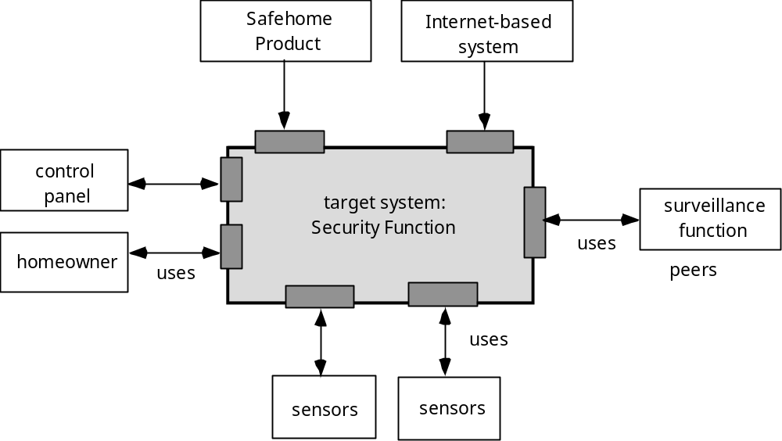
Architectural Context

Slide 9
Data Design

Slide 10
Purpose of Data Design
Data design translates data objects defined as part of the analysis model into
  Data structures at the software component level
  A possible database architecture at the application level
It focuses on the representation of data structures that are directly accessed by one or more software components
The challenge is to store and retrieve the data in such way that useful information can be extracted from the data environment
"Data quality is the difference between a data warehouse and a data garbage dump"

Slide 11
Data Design Principles
The systematic analysis principles that are applied to function and behavior should also be applied to data
All data structures and the operations to be performed on each one should be identified
A mechanism for defining the content of each data object should be established and used to define both data and the operations applied to it
Low-level data design decisions should be deferred until late in the design process
The representation of a data structure should be known only to those modules that must make direct use of the data contained within the structure
A library of useful data structures and the operations that may be applied to them should be developed
A software programming language should support the specification and realization of abstract data types

Slide 12
Software Architectural Styles

Slide 13
Software Architectural Style
The software that is built for computer-based systems exhibit one of many architectural styles
Each style describes a system category that encompasses
  A set of component types that perform a function required by the system
  A set of connectors (subroutine call, remote procedure call, data stream, socket) that enable communication, coordination, and cooperation among components
  Semantic constraints that define how components can be integrated to form the system
  A topological layout of the components indicating their runtime interrelationships
(Source: Bass, Clements, and Kazman. Software Architecture in Practice. Addison-Wesley, 2003)

Slide 14
A Taxonomy of Architectural Styles
Independent Components
Communicating
Processes
Event Systems
Implicit
Invocation
Explicit
Invocation
Client/Server
Peer-to-Peer
Data Flow
Data-Centered
Batch Sequential
Pipe and
Filter
Repository
Blackboard
Virtual Machine
Call and Return
Main Program
and Subroutine
Object
Oriented
Layered
Interpreter
Rule-Based
System
Remote Procedure Call

Slide 15
Data Flow Style
Validate
Sort
Update
Report

Slide 16
Data Flow Style
Has the goal of modifiability
Characterized by viewing the system as a series of transformations on successive pieces of input data
Data enters the system and then flows through the components one at a time until they are assigned to output or a data store
Batch sequential style
  The processing steps are independent components
  Each step runs to completion before the next step begins
Pipe-and-filter style
  Emphasizes the incremental transformation of data by successive components
  The filters incrementally transform the data (entering and exiting via streams)
  The filters use little contextual information and retain no state between instantiations
  The pipes are stateless and simply exist to move data between filters
(More on next slide)

Slide 17
Data Flow Style (continued)
Advantages
  Has a simplistic design in the limited ways in which the components interact with the environment
  Consists of no more and no less than the construction of its parts
  Simplifies reuse and maintenance
  Is easily made into a parallel or distributed execution in order to enhance system performance
Disadvantages
  Implicitly encourages a batch mentality so interactive applications are difficult to create in this style
  Ordering of filters can be difficult to maintain so the filters cannot cooperatively interact to solve a problem
  Exhibits poor performance
    Filters typically force the least common denominator of data representation (usually ASCII stream)
    Filter may need unlimited buffers if they cannot start producing output until they receive all of the input
    Each filter operates as a separate process or procedure call, thus incurring overhead in set-up and take-down time
(More on next slide)

Slide 18
Data Flow Style (continued)
Use this style when it makes sense to view your system as one that produces a well-defined easily identified output
  The output should be a direct result of sequentially transforming a well-defined easily identified input in a time-independent fashion

Slide 19
Call-and-Return Style
Main module
Subroutine B
Subroutine A
Subroutine A-1
Subroutine A-2
Application layer
Class V
Class W
Transport layer
Network layer
Class X
Class Y
Data layer
Class Z
Physical layer

Slide 20
Call-and-Return Style
Has the goal of modifiability and scalability
Has been the dominant architecture since the start of software development
Main program and subroutine style
  Decomposes a program hierarchically into small pieces (i.e., modules)
  Typically has a single thread of control that travels through various components in the hierarchy
Remote procedure call style
  Consists of main program and subroutine style of system that is decomposed into parts that are resident on computers connected via a network
  Strives to increase performance by distributing the computations and taking advantage of multiple processors
  Incurs a finite communication time between subroutine call and response
(More on next slide)

Slide 21
Call-and-Return Style (continued)
Object-oriented or abstract data type system
  Emphasizes the bundling of data and how to manipulate and access data
  Keeps the internal data representation hidden and allows access to the object only through provided operations
  Permits inheritance and polymorphism
Layered system
  Assigns components to layers in order to control inter-component interaction
  Only allows a layer to communicate with its immediate neighbor
  Assigns core functionality such as hardware interfacing or system kernel operations to the lowest layer
  Builds each successive layer on its predecessor, hiding the lower layer and providing services for the upper layer
  Is compromised by layer bridging that skips one or more layers to improve runtime performance
Use this style when the order of computation is fixed, when interfaces are specific, and when components can make no useful progress while awaiting the results of request to other components

Slide 22
Data-Centered Style
Client A
Client B
Client C
Shared Data
Client D
Client E
Client F

Slide 23
Data-Centered Style (continued)
Has the goal of integrating the data
Refers to systems in which the access and update of a widely accessed data store occur
A client runs on an independent thread of control
The shared data may be a passive repository or an active blackboard
  A blackboard notifies subscriber clients when changes occur in data of interest
At its heart is a centralized data store that communicates with a number of clients
Clients are relatively independent of each other so they can be added, removed, or changed in functionality
The data store is independent of the clients
(More on next slide)

Slide 24
Data-Centered Style (continued)
Use this style when a central issue is the storage, representation, management, and retrieval of a large amount of related persistent data
Note that this style becomes client/server if the clients are modeled as independent processes

Slide 25
Software Architecture…
- Captures the gross structure of a system
- How it is composed of interacting parts
- How the interactions take place
- Key properties of the parts
- Provides a way of analysing systems at a high level of abstraction !
- Illuminates top-level design decisions

Slide 26
Software Architecture Patterns
Architectural pattern are software patterns that offer well-established solutions to architectural problems in software engineering.
It gives description of the elements and relation type together with a set of constraints on how they may be used.
An architectural pattern expresses a fundamental structural organization schema for a software system, which consists of subsystems, their responsibilities and interrelations.
In comparison to design patterns, architectural patterns are larger in scale.

Slide 27




Typical architectural patterns (styles)
How can I integrate multiple applications so that they work together and can exchange information?
Integration styles for (enterprise) messaging
File Transfer
Shared Database
Remote Procedure
Messaging

Slide 28
Pipes and filters
The Pipes and Filters architectural pattern [style] provides a structure for systems that process a stream of data.
Each processing step is encapsulated in a filter component.
Data is passed through pipes between adjacent filters.
Recombining filters allows you to build families of related systems.

Slide 29
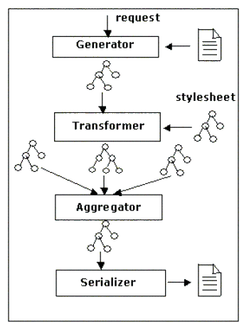
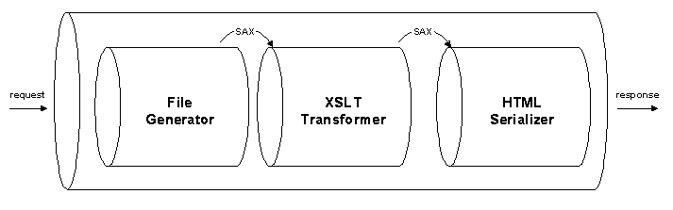
Example: apache cacoon’s pipes & xslt filters

Slide 30
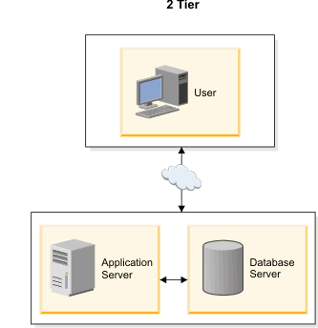
Tiered architecture (layering)
2 - tier architecture (traditional client-server)
A two-way interaction in a client/server environment, in which the user interface is stored in the client and the data are stored in the server. The application logic can be in either the client or the server.

Slide 31
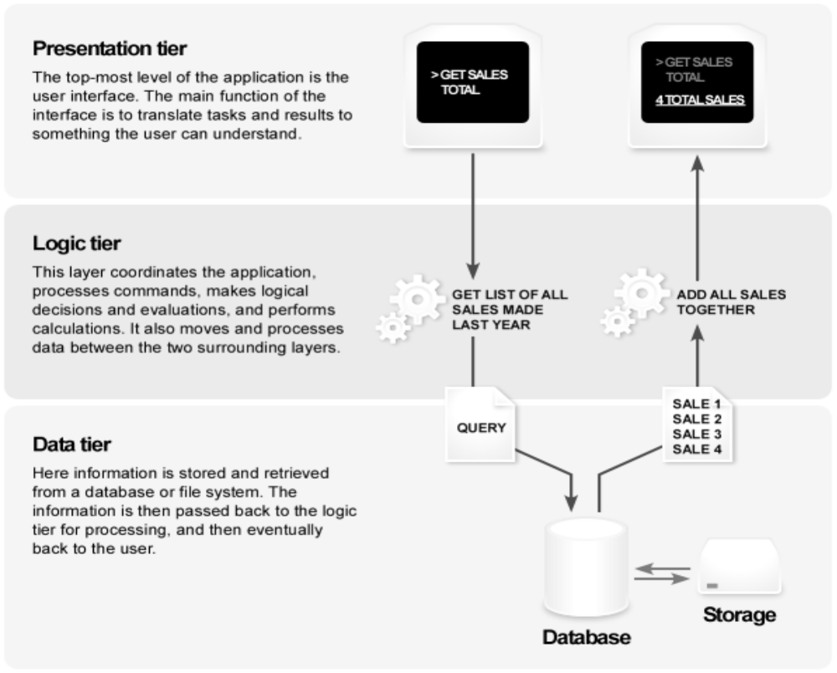
3 tier architecture

Slide 32
Model-view-controller (1)
The MVC paradigm is a way of breaking an application, or even just a piece of an application's interface, into three parts:
the model, the view, and the controller.
MVC was originally developed to map the traditional input, processing, output roles into the GUI realm:
Input → Processing → Output
Controller → Model → View

Slide 33
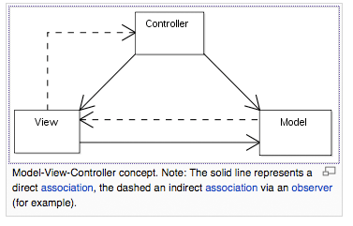
Model-view-controller (2)
The pattern isolates business logic from input and presentation, permitting independent development, testing and maintenance of each.

